Slide 1
Using Neural Networks for Classification on Real Data
Kevin Sim
Slides courtesy of Prof. Emma Hart

Slide 2
Overview
Recap
What kind of problems can we use NNs for
Dealing with data
Designing the neural network
Training the network
Backpropagation
Testing the network

Slide 3
Recap Simple Perceptrons
if
output 1, otherwise 0
Step Function:
w
Output value
w
Neuron
1
w
Threshold T
w
0
w
-2 -1 0 1 2
Activation value

Slide 4
Recap Simple Perceptrons
We can ignore the threshold by adding an extra input to those required by the application
The extra input is called the bias
*It always has input value -1
It has a weight w₀ which needs to be calculated
-1
x₁
w₁
w₀
x₂
w₂
∑w_{i}x_{i}
w₃
x₃
w₄
x₄
that in practice, most software assumes the input is actually +1 and the weight is –w (which achieves the same effect)
Notes:
We can forget about the threshold by always adding an extra input

Slide 5
Recap Simple Perceptrons
From last week: Simple Perceptrons are only useful if data is linearly separable
+
+
_
(0,1)
(1,1)
+
+
_
_
+
_
_
_
_
(0,0)
(1,0)
AND gate

Slide 6
Multi Layer Perceptrons
Most problems involve data that isn’t linearly separable
Single Perceptrons can be combined into multi-layer networks
In theory – any function can be approximated in this way

Slide 7
Multilayer perceptrons
A network that solves XOR
3 neurons are used
2 in a ‘hidden layer’ and 1 for the output
+1
+1
+1
+1
+1
-1
Output unit
Input units
Hidden Units

Slide 8
Learning XOR
-0.5
Hidden
Unit A
Hidden
Unit B
+1
input
output
B
1 1
1 0
0 1
0 0
1
0
0
0
1
1
1
0
0
1
1
0
-0.5
+1
+1
+1
-1
A
+1
-1.5
Output of hidden units becomes input to output unit

Slide 9
Role of the Hidden Units
Hidden
Unit A
Hidden
Unit B
input
output
1 1
1 0
0 1
0 0
1
0
0
0
1
1
1
0
0
1
1
0
Hidden Unit A is learning AND

Slide 10
Role of the Hidden Units
Hidden
Unit A
Hidden
Unit B
input
output
1 1
1 0
0 1
0 0
1
0
0
0
1
1
1
0
0
1
1
0
Hidden Unit B is learning OR

Slide 11
Effect of Hidden Units on Output
Hidden
Unit 1
Hidden
Unit 2
input
output
1 1
1 0
0 1
0 0
1
0
0
0
1
1
1
0
0
1
1
0
Output unit’s input is the output of hidden units
Note that now there are only 3 possible input pairs

Slide 12
Training multilayer Networks
The simple perceptron learning rule can’t be applied to a multi-layer network
As there is a knock-on effect with the output of one node being the input of the next
For any given input pattern, we can only easily calculate the error at the final output node(s)
we don’t know what the outputs for the hidden nodes should be
There are 2 ways to find the required weights:
Backpropagation (for supervised learning, this week)
Evolutionary Algorithm (unsupervised learning, next week)

Slide 13
Classification with MLPs
What kind of problems can we use NNs for
Dealing with data
Designing the neural network
Training the network (for classification)
Backpropagation
Testing the network

Slide 14
What kind of problems are NNs good at ?
Instances represented by many input-output pairs
Target function can be discrete-valued, real-valued, or a vector of real/discrete attributes
Training examples can contain errors
Long training times area acceptable
Fast evaluation of the learned target functions is required
The ability of humans to understand the learned target function is not important

Slide 15
And when they are not very good ….
If you need to understand the reasons behind output:
E.g medical applications – predicting a heart attack
No relationship between input and output variables
E.g day of the week -> weather forecast
No relationship between the past and the future
E.g predicting the lottery numbers for next week
Training data is very biased:
Only have examples from one particular class (e.g trying to predict class of degree but only have examples of students who obtained 2(1) and 3rd.)

Slide 16
Dealing with data
What kind of problems can we use NNs for
Dealing with data
Designing the neural network
Training the network (for classification)
Backpropagation
Testing the network

Slide 17
Dealing with data
Factors to consider
Available data
categorical, numerical, discrete, ordered
input encoding
Transforming the data
output encoding

Slide 18
Dealing with data
Real world data is likely to be messy
Neural networks need numerical inputs
Neural networks work best with inputs in range 0-1
Might have missing values for some attributes
Might have irrelevant values
Need to clean a data-set before trying to use with an NN

Slide 19
Dealing with data
Real world data is likely to be messy
Neural networks need numerical inputs
Neural networks work best with inputs in range 0-1
Real data has attributes of mixed type:
Continuous (1.34, 4.78 etc.)
Discrete (1,2,3)
Categorical (red, blue, yellow)

Slide 20
Dealing with data
Real world data is likely to be messy
Neural networks need numerical inputs
Neural networks work best with inputs in range 0-1
Real data has varied ranges:
0 to 10,000
-100 to 100

Slide 21
Example
Let’s use an example to illustrate how we can deal with data:
An estate agent want to use a neural network to predict house prices
Input = collected data
Output = price of house
Attribute | Type | Values
Location Rating | discrete | 1-10
House Condition | discrete | 1-10
Bedrooms | discrete | 1-8
Bathrooms | discrete | 1-6
Living Area | continuous | 50m²-250m²
Land Area | continuous | 100m²-1000m²
Garage | categorical | yes/no
Heating System | categorical | Wood, oil, gas, electric
PRICE | continuous | 52,500-225,000

Slide 22
Dealing with data: Continuous
Continuous data that varies between two preset values (minimum and maximum) can easily be normalised to gives values between 0 and 1
(WEKA does this for you automatically)
New value = actual value - minimum value
maximum value - minimum value

Slide 23
An Example
Area of houses in the training set varies between 59 and 231 square metres
Set minimum to 50 and maximum to 250
Leave some room at extremes for values that might not appear in your data
An area of say 121m² is then mapped to
New value of 121 = 121-50
= 0.355
250-50

Slide 24

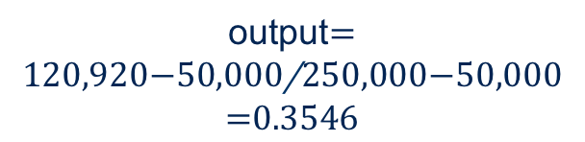
How do we convert the output to a price ?
We can do the same for the output:
Prices vary between £52500 and £225,000
Set up output so that £50000 maps to 0, and £25000 0 maps to 1
output$=\frac{120,920−50,000}{250,000−50,000}=0.3546$
Note that the NN is unlikely to be good on new data that is outside of the boundaries you set so choose them carefully

Slide 25
Discrete Data
Discrete data such as number of bedrooms, number of bathrooms, also has minimum and maximum values
Convert to numerical values on a scale:
0
No bedrooms
0
0.25
1 bedroom
1
Number of
bedrooms
2
0.5
2 bedrooms
3
3 bedrooms
0.75
>=4
More than 4 bedrooms
1

Slide 26
Categorical Data
For data with a fixed number of categories n, represent as n attributes where one attribute is 1 and the rest are 0
This is called a 1-of-N encoding (it uses N inputs of which 1 is set to 1)
Wood 1 0 0 0
Oil 0 1 0 0
Gas 0 0 1 0
Electric 0 0 0 1

Slide 27
Categorical Data
Don’t convert to a scale!
Wood 0.2
Oil 0.4
Gas 0.6
Electric 0.8
Why ?
It introduce as false ordering into the data
In categorical data, there is no ordering

Slide 28
Categorical Data
Also avoid converting to a ‘binary’ representation
E.g the 4 categorical values could be represented by 2 neurons:
Wood 00
Oil 01
Gas 10
Electric 11
Again this introduce a false notion of order and relationship

Slide 29
Dealing with Data
Using these rules, transform each record in your data set to a suitable format
location | condition | bedrooms | Bathrooms | Living area | Land area | Garage | Heating | PRICE
7 | 8 | 3 | 1 | 121 | 682 | yes | oil | £120,920
location | condition | bedrooms | Bathrooms | Living area | Land area | Garage |  | Heating |  |  |  | PRICE
0.7 | 0.8 | 0.75 | 0.5 | 0.355 | 0.468 | 0 | 1 | 0 | 1 | 0 | 0 | 0.3546
Notes:
Note we could have just used one neuron here – there are no hard rules – often just need to experiment

Slide 30
Dealt with data!
Now we have transformed each record in the dataset, we are ready to design the neural network
Note:
WEKA will default to normalise all numeric data (in the GUI or the libraries)
It will automatically use the 1-of-N representation for nominal data
If for some reason you want to do it before using a classifier, you can do it in Excel

Slide 31
Designing the Neural Network

Slide 32
Neural Network Architecture
A neural network design has three steps:
Select number of input neurons
Select number of output neurons
Select number of hidden layers and number of neurons in each hidden layer

Slide 33
Steps 1 and 2
The first two steps are easy:
The number of input and output neurons are determined by our transformed data:
Input neurons = 12
Output neurons = 1
location | condition | Bedrooms | Bathrooms | Living area | Land area | Garage |  | Heating |  |  |  | PRICE
0.7 | 0.8 | 0.75 | 0.5 | 0.355 | 0.468 | 0 | 1 | 0 | 1 | 0 | 0 | 0.3546
input
output

Slide 34
Hidden Layers
How many hidden layers ?
Too many makes computation too difficult
Too few cannot detect complex patterns
Weka uses a heuristic to get a start point:
1 hidden layer with (inputs+outputs)/2 neurons
Start with a small number and increase as necessary:
E.g start with 1 hidden layer
Choose small number of neurons
This is not an exact science…
There are no rules – other than trial and error
Notes:
In practice – if you are not getting anywhere, try increasing the neurons

Slide 35
Ockhams Razor
14th century philosopher William of Ockham stated:
The simplest hypothesis is preferred
Lots of hidden layers and neurons maps to a very complex function
Need to take care that we are not learning the data exactly
Rather, we are learning patterns from the data so the neural network can generalise

Slide 36
Training the network

Slide 37
Training
You have some data and an architecture…
You now need to train the network
Training means teaching the network to find patterns in a data-set
Once it’s learnt, the network should produce correct classifications on unseen data

Slide 38
Dealing with data first
First, split the data in two separate sets:
A training set and a test set
Usually in the proportion ~70:30
Why ?
We can only test if the network has generalised properly by giving it unseen data
Used to train the network to recognise patterns
Training Set
Test Set
Used to test the trained network to see if it has generalised

Slide 39
Dealing with data first
Be careful to ensure that the training and test sets both contain examples of each of the classes you are trying to predict
The network can’t learn without examples
Typically, place every 5th record in data set into training or select randomly
E.g in house data, training set should contain examples of houses in all price ranges (low, medium, high)
In a credit-application example, training set needs to contain both yes and no examples

Slide 40
Training the Network
Take the prepared training set of examples:
For each record in the training set:
Pass the input data through the network
Measure the (squared output) error at the output by comparing the actual result to the desired result
Apply a learning algorithm to change weights
(usually backpropagation..)
Repeat set (2) until error converges
(Remains stationary or reaches a value close to zero)

Slide 41
Training Procedures
Usually stop training when the network converges, but…
Training set error
Error
Number of weight updates
-it is important to beware of overfitting

Slide 42
What is overfitting ?
It is possible to ‘overtrain’ a network
E.g teach it to the extent it simply memorises the patterns in the test set rather than generalises from them
Occurs it you train too long or have too many hidden nodes
In this case, you will get excellent performance on the training set (very small error) but very weak performance when you try the test set
For example:
Consider a network you are training to recognise letters in a printed document
An overfitted network trained on Helvetica font might not recognise the same letter in the Times Roman font

Slide 43
What is overfitting ?
+
+
_
+
+
_
_
+
_
_
_
_
We want to learn patterns in the data
So that we can generalise to unseen instances

Slide 44
What is overfitting ?
+
+
_
+
+
_
_
+
_
_
_
+
_
We want to learn patterns in the data
So that we can generalise to unseen instances

Slide 45
What is overfitting ?
+
+
_
+
+
_
_
+
_
_
_
+
_
We don’t want to model the data exactly
Our network will perform badly when presented with unseen instances

Slide 46
Preventing overfitting
Divide the training data into a training set and validation set
Update weights based on error in training set
Monitor how well the network performs on a separate validation set
But don’t adjust any weights based on this performance
Choose the set of weights which give the lowest error on the validation set
At this point here, validation error starts to increase, indicating the network is starting to memorise training data
Error
Validation set error
Training set error
Number of weight updates

Slide 47
Training the Network
What if it doesn’t converge ?
Change the architecture
increase number of neurons in the hidden layer (start with 2, increase to 5,10, 20….)
Change the learning parameters….

Slide 48
Backpropagation

Slide 49
Training multilayer Networks
The simple perceptron learning rule can’t be applied to a multi-layer network
As there is a knock-on effect with the output of one node being the input of the next
For any given input pattern, we can calculate the error at the final output node(s)
Given this error, we need to apportion blame across all the weights in the network

Slide 50
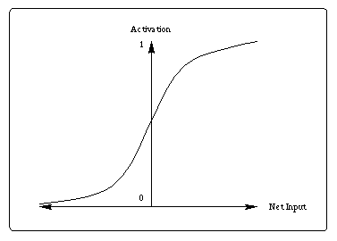
How do the weights affect the error ?
Error = desired output – actual output
If the output it too high:
Reduce the weights a bit
If the output is too low
Increase the weights a bit
Easy for output neurons
We know what the desired output is!

Slide 51
What about hidden neurons ?
Error = desired output – actual output
What should the hidden neurons output ?
We don’t know!!
output 1
output 2

Slide 52
Backpropagation
Backprop is a technique that calculates the errors and adjusts weights accordingly
It calculates the error at the outputs
Adjust the weights to the output layer so that if the same input pattern is presented again, the error will be reduced
Repeat the process at the next layer back
And so on until you reach the first layer
The next time the same input pattern is presented, the error should be smaller
Repeat…….

Slide 53
Back propagation
outputs
Calculate error
w
w
w
Readjust weights
bias
Calculate error
w
w
w
w
Readjust weights
w
w
inputs
Present input pattern(s)

Slide 54
Backpropagation
The Backprop Algorithm:
For each pattern presented it:
Calculates error at output (easy)
Changes weights to output layer to reduce this error
Calculates error at last-but-one layer (harder)
Changes weights to reduce this
Repeat….
The algorithm is applied each iteration until the network error is minimised

Slide 55
Backpropagation
Initialize network weights (often small random values)
do forEach training example
prediction = neural-net-output // forward pass
actual = known_value_from_training_record
compute error (prediction - actual) at the output units
compute d(w) for all weights from hidden layer to output layer // backward pass
compute d(w) for all weights from input layer to hidden layer // backward pass continued
update network weights
until all examples classified correctly or another stopping criterion satisfied
return the network

Slide 56
How does it actually work ?
In practice with a lot of complicated differential equations!
One set calculates the error at the output
Another calculates how to adjust the weights to the output
Another set calculates error in the hidden layers
Another set defines how to adjust weights to hidden layers

Slide 57
Backpropagation
At each iteration, the weights are adjusting according to an equation of the form:
where α = learning rate
a_{j} = input to k_{th} neuron ( output of j_{th} neuron)
Δ_{k} is the error at the j_{th} neuron
α , the learning rate, can be controlled by the user
Adjusting the value (between 0 and 1) controls how fast the backprop algorithm finds the correct weights

Slide 58
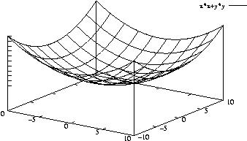
The Backpropagation technique
Each combination of weights has an associated error
If we could plot the high-dimensional surface of weights vs error we would have some complex surface
Backprop is trying to find the minimum point on this surface
It adjust weights so that we move down the slope toward the minumum
Minimum error
error
Weight 2
Weight 1

Slide 59
The Backpropagation technique
The learning rate α affects the size of the step we take down the slope
Too small:
Might never reach the minum
Too big:
Might overshoot
Minimum error
error
Weight 2
Weight 1

Slide 60
Another parameter
Another version of backpropagation adds something called momentum to try and speed up learning
Let’s look at why:

Slide 61
Another parameter
The error surface might have local optima
These are minima in the error surface – but are not the global minimum
Momentum works by adding an extra term to the weight adjustment that encourage the algorithm to adjust the weights in the same direction as the previous step
Typically set between 0.0 and 1.0
Local minimum
Global minimum
Notes:
Think about a ball rolling down a hill: if it has enough momentum, if it hits a small depression, it is likely to jump over it and carry on going in the same direction

Slide 62
In practice
All NN software/libraries has backpropagation built in
You don’t need to program it!
As the software engineer, you have to supply two things:
The learning rate
The momentum term (if required)
Can be done in WEKA either through the GUI or in code

Slide 63
In practice
It is very unlikely that you will get a good result (low error on the training set) the first time you try and train the network
The training procedure can be time-consuming:
Try different architectures
Try different learning rates
Try different momentum values
Try representing the data differently
……

Slide 64
TESTING

Slide 65

Testing
You’ve prepared the data
Trained the network
The training error is reduced to almost zero
How well does your network work on the test data ?

Slide 66
Testing Procedure
Take your trained network
For each record in the unseen test-set:
Feed the inputs into the trained network
Record the output for each input
Compare against the known desired output
How can we quantify the performance ?

Slide 67
Quantifying performance:
For real-valued output we can calculate the total squared error across the whole test set for each network we have trained
The network with minimum error is preferred
We might define some acceptable tolerance level depending on the application

Slide 68
Quantifying data:
For some applications, we want to predict a class:
Example: a bank rates a customer’s credit risk as high medium or low depending on some collected data
Output might be 3 neurons:
Neuron with highest value is the winner
high
0.01
medium
0.97
low
0.003

Slide 69
Classification Rate
In this case we can count the percentage of records for which the correct class was predicted and report that
We can also report % correct prediction for each of the 3 classes
Overall classification rate: 80%
% High 100%
% Medium 80%
% Low 60%
Notes:
Might tell us if some classes are hard to predict

Slide 70
More about classification
Consider a binary classifcation problem: e.g predicting attack/non-attack in virus detection:
There are P records which are attack and N records that are non-attack
True positive (TP)
% of records classified as attack that were really attack
False positive (FP)
% of records classified as attack that were not attack
True Negative (TN)
% of records classifed as non-attack that were non-attack
False Negative (FN)
% of records classified as non-attack that were attack

Slide 71
Illustrating Performance
Sensitivity (sometimes called recall):
TP/(TP+FN)
Accuracy
(TP+TN)(P+N)
Specificity
TN/(FP+TN)
Confusion Matrix
Actual value
p
n
True
Positive
False
positive
p’
Prediction outcome
False
negative
True
negative
n’

Slide 72
Some examples

Slide 73
Character Recognition Neural Networks
Recognition of printed or handwritten characters is a typical NN application
Documents can be scanned and then edited without retyping
Scanning divides the image into hundreds of pixel sized boxes
Each box is represented by a 0 or 1 (empty of full)
Resulting matrix of dots is called a bitmap
NNs learn to recognise the bit-maps as characters

Slide 74
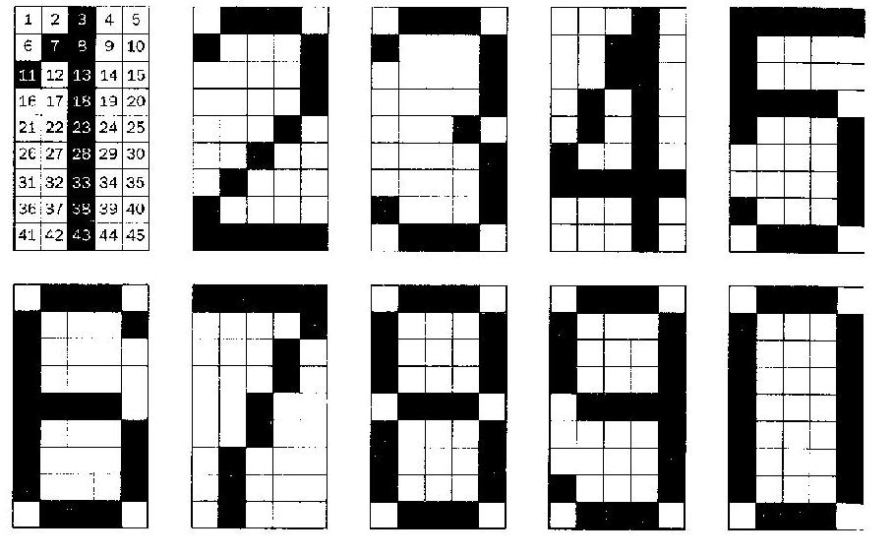
Character Bit Map Input Data

Slide 75
Character Recognition
Task is to recognise digits 0-9
Each digit represented by a 5x9 bitmap
1 neuron for pixel = 45 input neurons, with value 0 or 1
(In commercial applications, use higher resolution, e.g 16x16)
Network must output the correct digit, given some (possibly noisy) input
10 output neurons, one has value 1, the others 0

Slide 76
Neural Network for Digit Recognition
0
0
1
0
1
2
0
1
3
1
1
4
…
0
0
1
43
0
1
44
0
1
45
0
0

Slide 77
ALVINN - another real example
NN to steer an autonomous vehicle driving at normal speeds on public roads
Input is 30x32 grid of pixel intensities obtained from a camera (real values)
Output is direction to steer - there are 30 outputs corresponding to particular directions, winner is output with highest value
ALVINN has been used to drive at speeds of 70 mph for 90 miles (in left hand lane!) on public highways with other vehicles present

Slide 78
ALVINN
30 output units
Sharp left
Straight ahead
Sharp right
…...
…...
4 hidden units
30x32 input units

Slide 79
Summary
In this lecture you have learned
What kind of problems can we use NNs for
Dealing with data
Designing the neural network
Training the network
Backpropagation
Testing the network

